Slide 1

Artificial Intelligence in Finance at Hong Kong University of Science and Technology
Notes:
What does “greedy” refer to for “greedy algorithm”?
Optimal at the current step
Monetary reward gained in the training process
Binary splitting using neural networks
None of the above
What happens when there are too few steps of splitting in a tree?
Large bias, large variance
Large bias, small variance
Small bias, large variance
Small bias, small variance
In a decision tree, if the current split is ineffective, future splits can still be effective (even very effective).
True
False
Which of the following are usually used to evaluate the quality of a split in a classification tree?
Gini-index and splitting bias
Cross-entropy and splitting bias
Gini-index and cross-entropy
All of the above
Which of the following is true about bagging?
Works best for high variance and high bias learning methods
Works best for high variance and low bias learning methods
Works best for low variance and high bias learning methods
Works best for low variance and low bias learning methods
Which of the following is true about boosting?
A combination of many weaker learners to produce a strong learner.
Weaker learners are usually created in parallel.
Boosting is only applicable for classification problems.
None of the above

Slide 2
www.slido.com
#UST

Slide 3
Final Assignment & Presentation
NO exam
Final assignment (group) in the form of an eight (8)-page report based on the NIPS format documenting:
Progress and learning from group project (technical report)
Reflection on an AI article and a finance one (essay)
Synthesis and suggestions for further study
Note individual contribution
Final presentation (group) in short YouTube videos (10 mins)
Peer review for both final assignments and final presentations
Due date: May 26, 2019 (Sunday)

Slide 4
Date | Topic | Instructor
01/02/2019, Fri | Lecture 01: History and Overview of Artificial Intelligence. [ slides ] | A.W. and Y.Y.
15/02/2018, Fri | Lecture 02: Introduction to Supervised Learning [ YY's slides ][ Topic ]Google Experiments: Vision Sensing and Case study: HireVue (Video Analytics for Recruitment)[ AW's slides ] | A.W. Y.Y.
02/22/2019, Fri | Lecture 03: Regression, Classification, Model Assessment and Selection [ YY's slides ] [Reference]:ISLR, Chapter 3-6. [ Topic ]:Katrina Fong's talk [ AW's slides ] | Y.Y.
03/1/2019, Fri | Lecture 04: Decision Tree, Random Forests and Boosting [ YY's slides ] [Reference]:ISLR, Chapter 3-6. [ Topic ]Credit analysis and Mock interview by Katrina [ AW's slides ] | Y.Y.
03/8/2019, Fri | Lecture 05: Tutorials [Reference]:Yifei HUANG: Tutorial on Machine Learning by Python Yifei HUANG: Tutorial on GPU server A dataset used in python tutorial: okex_future_BTC_USD_this_week_1H.csv File links in Piazza >> | Yifei Huang; Katrina Fong; Anthony Woo
03/15/2019, Fri | Lecture 06. Topics in Blockchains [ Invited Talk ]: Fintech and BlockchainSpeaker: Dr. Alex YANG, CEO, VEE Technology LLC and Dr. Chen NING. Abstract: This is a brief introduction of Blockchain consensus and its current application in Finance, V.Systems’ vision and outlook of Blockchain in Fintech. Bio: Dr Alex Yang is a FinTech entrepreneur/investor with over 14 years of experience in banking and finance. VEE Technology is led by Sunny King, a blockchain legendary developer and creator of Proof-of-Stake consensus. As CEO of VEE Tech, Alex is driving the project to solve the core scalability and stability problems in the development of the blockchain industry. His deep experience of the industry has been gained through his investing activity where he has sponsored many world-leading blockchain foundations. Prior to his role at VEE, Alex was the founder and CEO of Fund V, one of the first token funds to focus on blockchain companies and related investment opportunities. He was also the founding partner of Beam VC and CyberCarrier Capital which together have successfully invested in over 30 startups in the TMT sector. Alex is a founding partner of Protoss Global Opportunity Fund, a fixed income hedge fund based in Hong Kong. Prior to moving into venture capital investing, Alex was based in Hong Kong as head of APAC structured rates trading at Nomura International, and VP of exotic derivatives trading at UBS. He started his career as a quantitative developer at Jump Trading in Chicago. Alex has a PhD from Northwestern University and a BA in Mathematics from Peking University. An Introduction to Blockchains: [ AW's slides ] | A.W. Y.Y.
03/22/2019, Fri | Lecture 07: An Introduction to Neural Networks and Deep Learning [Reference]:[ slides-A ] [ slides-B ] [ Invited Talk ]Speaker: Dr. Jeffrey Hui Title: Igniting the i-Marketing Revolution - 5 KEY Digital and Social Media Trends in 2019+ [ slides ] | A.W. Y.Y.

Slide 5
Date | Topic | Instructor
03/29/2019, Fri | Lecture 08: An Introduction to Recurrent Neural Networks (RNN) and Long Short Term Memory (LSTM) [Reference]:[ slides ] [ Topic ]Google Image Recognition. Case study: SenseTime (Computer Vision) [ slides ] | A.W. Y.Y.
04/12/2019, Fri | Lecture 09: An Introduction to Reinforcement Learning [ YY's slides ] [ Topic ]:Competition of Cryptocurrency Trading with Deep Learning, by DE LAVERGNE Cyril [ slides ] Introduction to Deep Reinforcement Learning Trading, by HUANG Yifei [ slides ] [ Reference ]:Cyril's training dataset and demos [ link ] Ceruleanacg's GitHub Repo for Reinforcement Learning and Supervized Learning Methods and Envs For Quantitative Trading | Cyril DE LAVERGNE Y.Y.
04/26/2019, Fri | Lecture 10: An Introduction to Unsupervised Learning: PCA, AutoEncoder, VAE, and GANs [Reference]:[ slides ] | A.W. Y.Y.
05/03/2019, Fri | Seminar: Investment Trends and FinTech Outlook [ Invited Talk ]:Focus : Sales and Trading Business in Global Investment Banks – Ripe for Disruption by AI? Speaker: Mr. Christopher Lee Biography: Mr. Chris Lee is a partner at FAA Investments and a board director with expertise in financial markets, risk management, governance and leadership development. Currently, he serves as an Independent Board Member with Matthews Asia Funds (AUM: US$30.2 billion), the largest US investment company with a focus on Asia Pacific markets and Asian Masters Fund, an investment company listed in Australia. Previously, Chris was an investment banker for 18 years, acting as Managing Director and divisional and regional heads at Deutsche Bank AG, UBS Investment Bank and Bank of America Merrill Lynch. He worked in global capital markets, managed derivative products, and provided equity sales and trading functions to institutional investors. Academically, Chris is an associate professor of science practice at HKUST and teaches financial mathematics and risk management courses. He completed the AMP at Harvard University and holds a BS in Mechanical Engineering and an MBA from U.C. Berkeley. Bloomberg Profile: [ link ] | Chris Lee A.W.
05/10/2019, Fri | Lecture 12: Tutorial on deep learning in Python [Reference]:[ Python Notebook ] | Yifei Huang
05/17/2019, Fri | Lecture 13: Final [Reference]:[ slides ] | A.W.

Slide 6


Frontier Technologies & Applications
Pushing yourself out of your comfort zone
AI Chipset
Drug Discovery AI
World’s best-performing cybersecurity solutions provider
Proprietary deep learning framework designed for cybersecurity
Zero-day threat detection and prevention
A step beyond signature-based virus and malware detection
World’s first and only certified company offering fully-autonomous BVLOS (Beyond Visual Line of Sight) drone solutions
Potential to become platform for scaled aerial data analytics, and become a critical enabler of AI/ML ecosystem
Foundational role for the future of smart cities
AI chipset optimized for parallel processing
Radical architectural design allows for scaling down for edge intelligence
Vast market potential in low power, low cost, high volume use cases
Dynamic Reconfigurable Systolic Array eliminating I/O bottlenecks
World’s best results for new drug hit discovery, binding affinity prediction, and toxicity detection
Utilizes deep learning (3D convolutional neural networks) for structure-based drug discovery
Enabler of drug discovery in an extremely large and diverse chemical space (order of magnitude: 10⁶⁰)

Slide 7
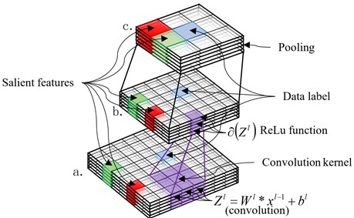
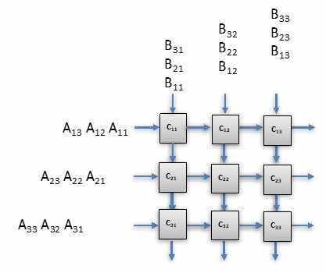

Slide 8
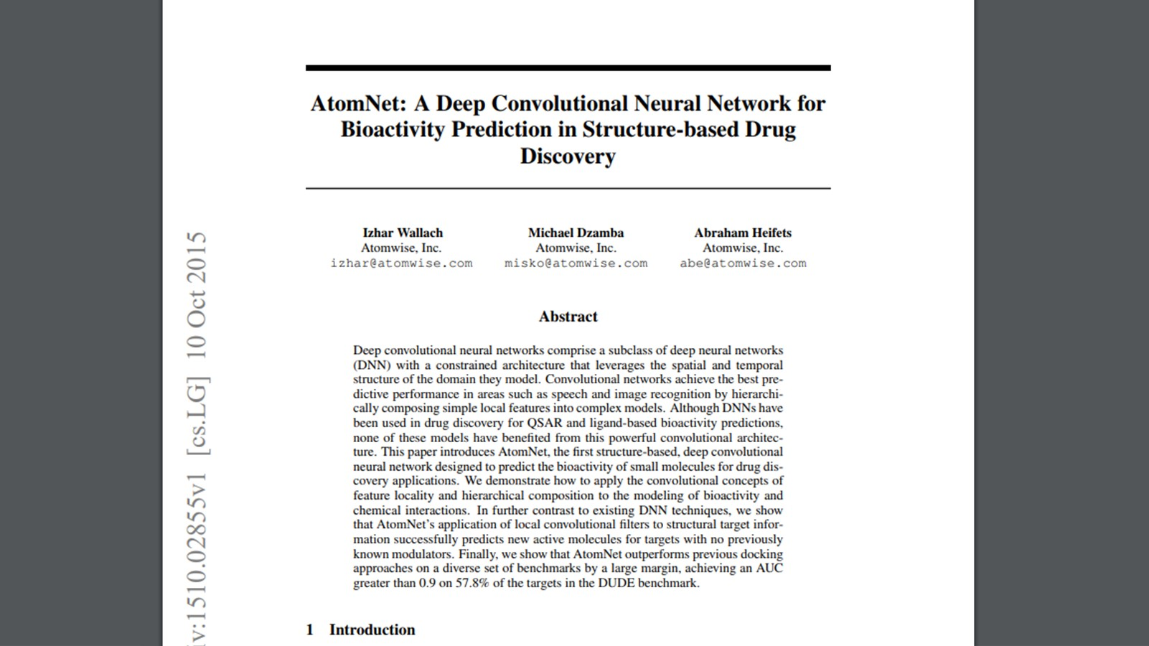

Slide 9
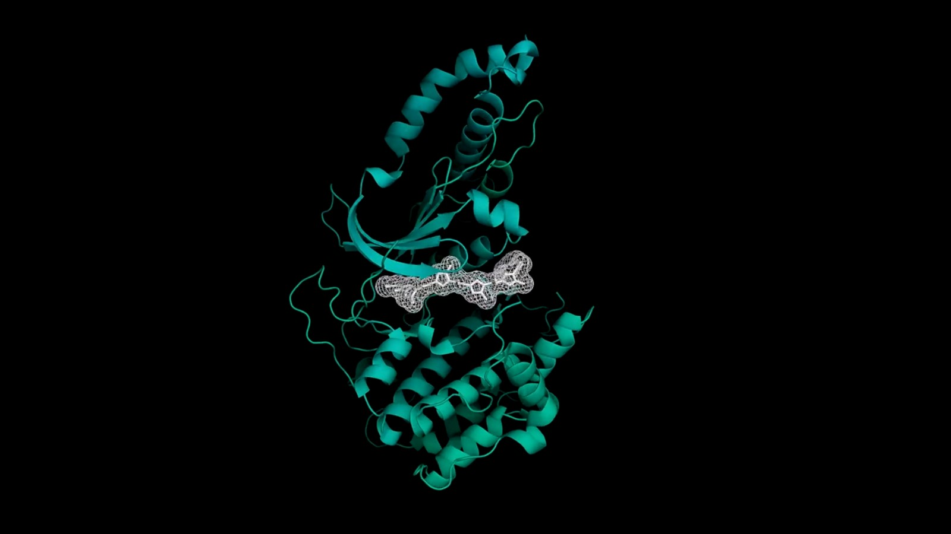

Slide 10
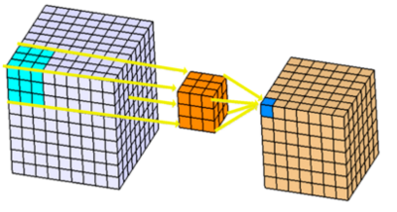
Convolution: 2D & 3D
Credits: https://leonardoaraujosantos.gitbooks.io/artificial-inteligence/content/convolution.html, https://www.kaggle.com/shivamb/3d-convolutions-understanding-use-case

Slide 11
Explainability & Usability

Slide 12
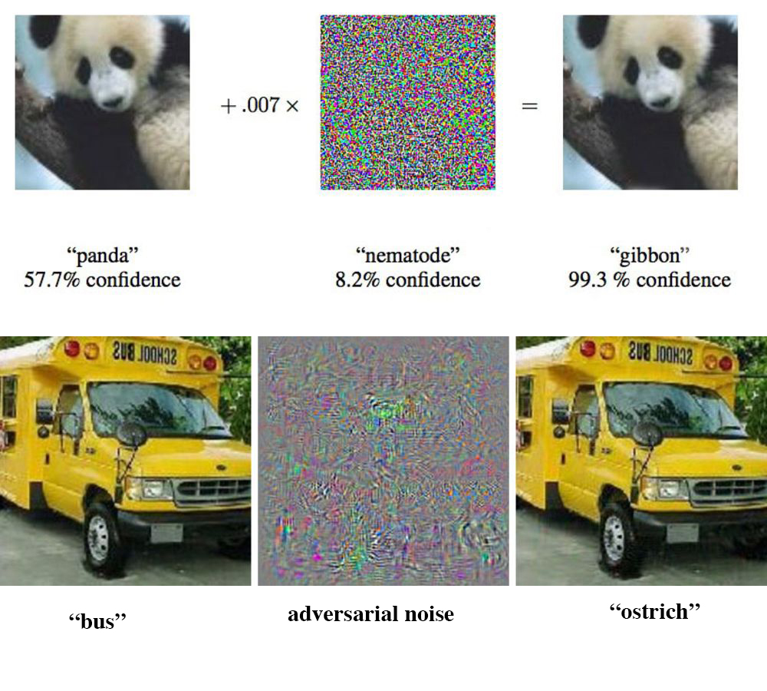
Adversarial Examples in Deep Learning

Slide 13



Predictive Maintenance
预测性维护
Drug Discovery
药物研发
General Purpose Decision Engine
通用决策引擎
Hypothetical Scenario Generator
假设场景生成器
Symbolic Reasoning
符号推理
Reinforcement Learning
强化学习
Generative Adversarial Networks
生成对抗网络
Computational Biology
计算生物学
Convolutional Neural Networks
卷积神经网络
Probabilistic Modeling
概率建模
Reinforcement Learning
强化学习
Multi-Agent Systems
多代理系统

Slide 14
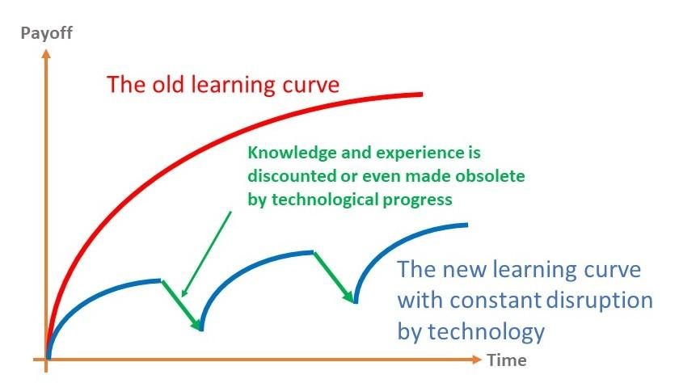

Slide 15
如果我不是技术出身 • 怎么办？
参与研讨会，与专家交流
网上讲座及课程（Coursera, Udacity）
数据科学、大数据或人工智能硕士（Berkeley）
学习相关职业发展或高管课程（如：MIT CSAIL）
大量阅读期刊文章（NIPS, ICML, ICCV, CVPR）

